Slide 1
Analysis of S&P 500 sector performance
during crash
Analysis of 11 sectors in the S&P 500
By: Ash Tao

Slide 2
Content
Who needs the solution
What is the business problem
What questions can solve the problem?
Exploratory Data Analysis(EDA)
Questions have been answered
What Limitations
How Solution Can Be Improved

Slide 3
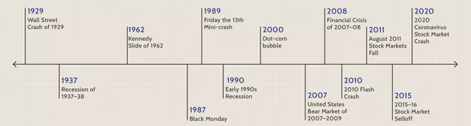
Who needs the solution Key Stakeholders: Investor who is interest in US Market
Investor
Share Holder
Crash | Start Date | End Date | Changes
2015 August Stock Market Selloff | 2015-08-17 | 2015-11-03 | 11.17%
Bitcoin Crash | 2018-09-20 | 2019-04-23 | 19.15%
Covid - 19 | 2020-02-19 | 2020-08-18 | 33.92%
Russian Invasion of Ukraine | 2022-02-09 | 2022-03-29 | 9.08%
Analysis
Notes:
llllllllllll

Slide 4
What is the business problem
The understanding of sector performance in a crash can help stakeholders avoid risks and improve returns.
3 Pain-Points
for stakeholders
Anticipate the coming of crash in advance
Avoid the sector with the most losses in a crash
Find the sector with the less losses in a crash

Slide 5
What questions can solve the problem?
Can we tell the trend from the cause of the crash?
What makes one sector perform differently from the the others?
Can the previous price help to make a judgment on sector performance?
Is there a correlation between sectors?
Would it be dangerous now to buy or keep holding the ENERGY sector?

Slide 6
Exploratory Data Analysis (EDA)
Key Insights:
MA(Moving Average) can help to predict the trend in certain condition.
The correlation between sectors increases over time. The daily returns of most sectors are closely related to others in the recent crash.
Price is not the only measure of risk. When judging sector performance, other things also need to be considered. e.g., weight.

Slide 7
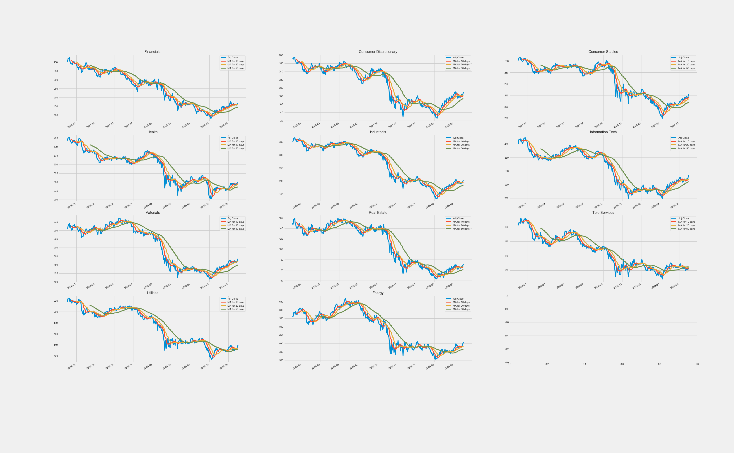
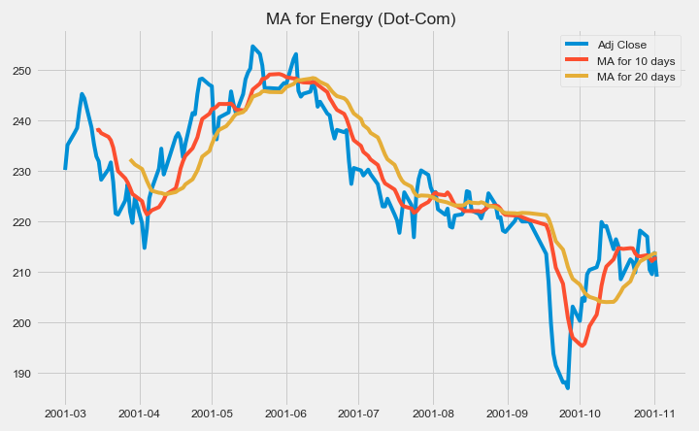
Questions have been answered
1st question: Can the previous price help to make a judgment on sector performance?
The moving averages can help to identify trend direction and to determine support and resistance levels.
We can judge the by the crossover on the closing price and the moving average line. When the price crosses above or below a moving average, there will be a signal for the potential change in trend.
We can judge by the crossover on the short-term and long-term moving average line. When the shorter-term MA crosses above the longer-term MA, it's a buy signal, as it indicates that the trend is shifting up. Meanwhile, when the shorter-term MA crosses below the longer-term MA, it's a sell signal, as it indicates that the trend is going down.
Notes:
If prices start to fluctuate will generate multiple trend reversals or trade signals. And sometimes the market won't respect MA support/resistance trade signals. We will need another indicator to help clarify the trend. Moving averages work well in strong trending conditions but poorly in choppy or ranging conditions.

Slide 8
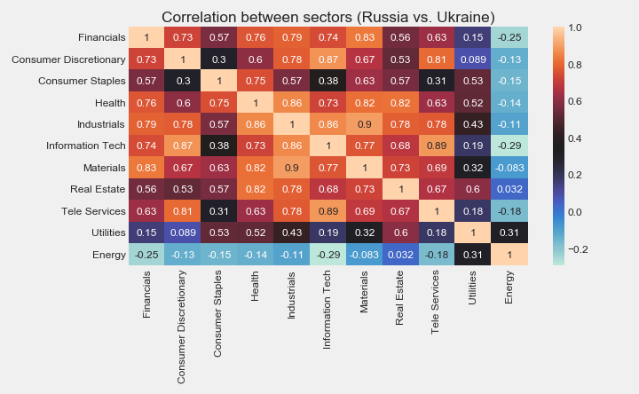
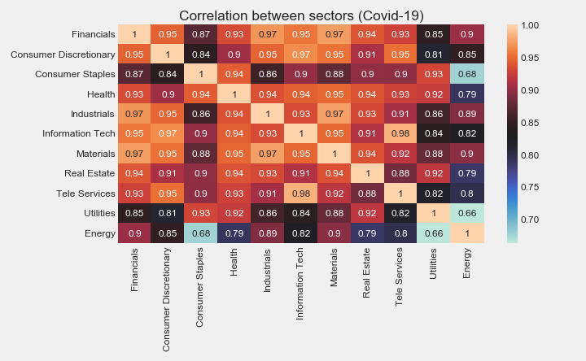
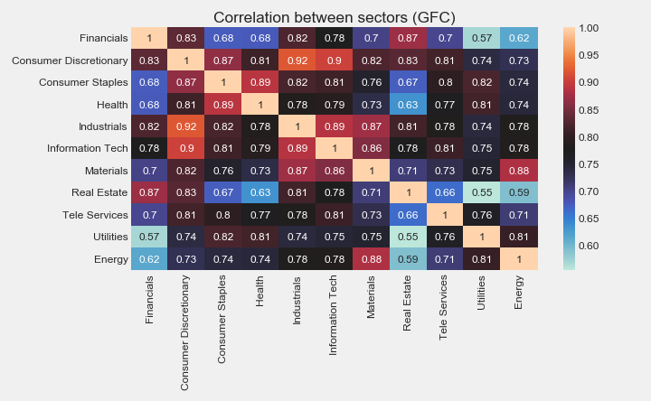
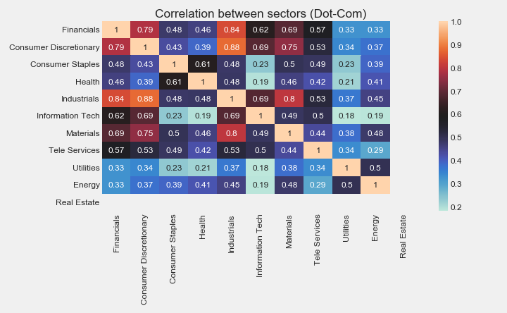
Questions have been answered
2nd question: Is there a correlation between the sectors?
Yes, based on the heat map related to the daily return.
The correlations are getting tighter over time.
Therefore, during the crash, no matter which sector you invest in, it will be influenced by other sectors. It is not easy to say whether there is a specific sector that is independent from the others.

Slide 9
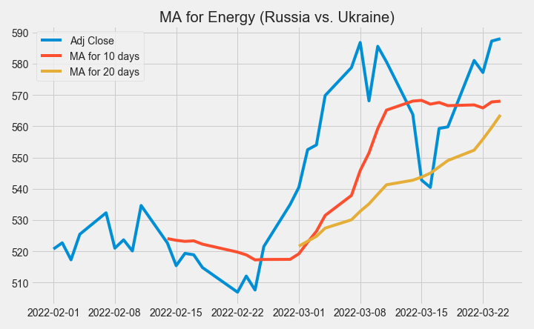
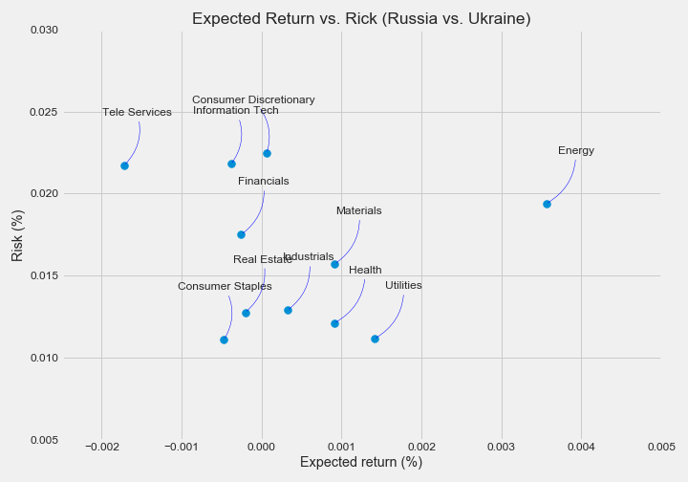
Questions have been answered
3rd question: Will it be dangerous now to buy or hold ENERGY?
Moving Average (MA) plot tells us that at the current point, the price is supported weakly, and the sector has a downward trend.
Expected return vs. Risk plot tells us that the sector has the highest expects return, but among the 11 sectors, it is only safer than 3, but more dangerous than the remaining 10.
However, if you consider the reduction of sector weight in recent years, the current price is still reasonable.

Slide 10
What Limitations
The data of the sector is not direct data.
It is calculated by the figures from each stock under that sector. The reliability of the data is not as high as a stock.
If we can break down the selected sample, analyse individual stocks instead of the 11 sectors. If we can expand the size of the project, perform data analysis in a larger dataset, such as studying the top 20 stocks in each sector. The results may be more convincing.
4 selected crash periods have different causes.
The cause of crash is an important dimension to study a crash. The impact of “Black Swans” and “Grey Rhinos” on the market is very different. In this study, the crash we selected includes both the predictable crash with a high possibility and the unpredictable crash with a low possibility.
If we can select crashes with more similar causes for research, the conclusions obtained may be more helpful for relevant personnel to obtain the judgments they need

Slide 11
How Solution Can Be Improved
The data of the sector is not direct data.
It is calculated by the figures from each stock under that sector. The reliability of the data is not as high as a stock.
If we can break down the selected sample, analyse individual stocks instead of the 11 sectors. If we can expand the size of the project, perform data analysis in a larger dataset, such as studying the top 20 stocks in each sector. The results may be more convincing.
4 selected crash periods have different causes.
The cause of crash is an important dimension to study a crash. The impact of “Black Swans” and “Grey Rhinos” on the market is very different. In this study, the crash we selected includes both the predictable crash with a high possibility and the unpredictable crash with a low possibility.
If we can select crashes with more similar causes, the conclusions may be more useful for getting a judgments people need.

